Slide 1
MILLILOTUS
Dr Gokul Krishna K

Slide 2
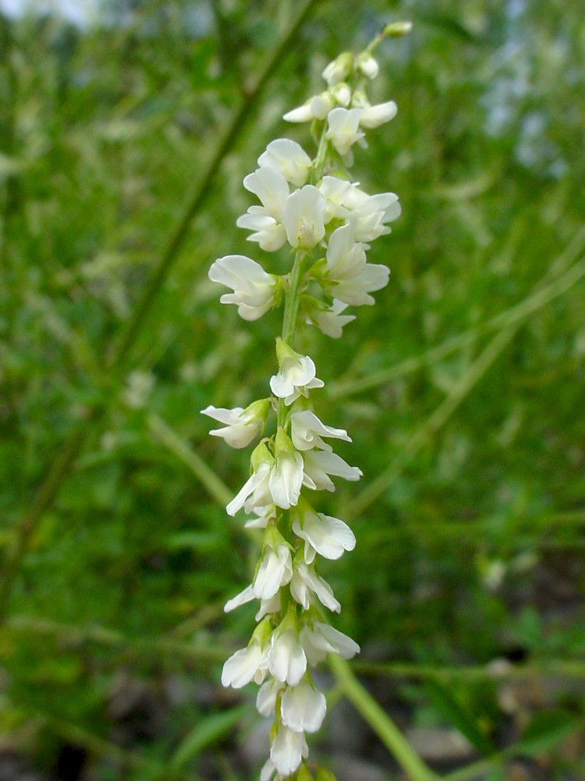

Slide 6
Common name: Yellow Sweet Clover, kings-clover, sweet clover, sweet lucerne, yellow melilot
Botanical name: Melilotus officinalis
Family: Fabaceae (Pea family)

Slide 7
Spheres of action:
Nervous system
Neuralgias, Pains, Sciatica.
Blood vessel
Engorgement, Congestion, Haemorrhage.
Mucous membranes
Ulcers, GI mucosa,

Slide 8
The pleasant smell of sweet clover is due to the presence of coumarin
MEDICINAL USES
Antibacterial,anticoagulant, astringent.
The plant is very helpful in removing gas from the digestive system and in inducing urination.

Slide 9
It can improve blood circulation, and be of great help in treatments of varicose veins and hemorrhoids.

Slide 10
It can also be helpful in treatments of wounds, cuts and bruises.
Used in form of a tea, Yellow Sweetclower is beneficial in cases of nervous tensions, painful menstruation, insomnia and palpitations.

Slide 11
Use in folk medicine:
As constricting and softening agent for hot tempered ulceration of eyes, anus and genitals.
Orally taken- it was used against stomach ache, gastric ulcer and disorders of uterus and liver.

Slide 12
Hippocrates used melilot flowers externally for septic ulcers.
external use of melilot in honey for facial spots as well as oral use of chopped drug in vine for bladder disorders.

Slide 13
History
Matthiolus (1626) describes external use of melilot in case of stomach ache or headache and skin rash due to mycosis.
Leclerc (1976) numbers melilot to be among antispasmodics and recommends it in case of insomnia in children or elderly.

Slide 14
Madaus (1938) summarizes the external use of melilot on ulcers, tumours, swelling of rheumatic joints and inflamed breasts of breastfeeding women.

Slide 15
SYMPTOMS
Mind
Unable to fix mind.
Stupor.
Wants to run away and hide.
Thinks every one is looking at her, fears to talk loud etc.

Slide 16
Head
Headache with retching, vomiting, sense of pressure over orbits, pallor, cold hands and feet, black spots before eyes.
Heavy, oppressed; frontal, throbbing, undulating sensation in brain.

Slide 17
Sick headache; relieved by epistaxis or menstrual flow.
Fullness all over head.

Slide 18
EYES
Eyes heavy; blurred sight; wants to close them tightly for relief.
Neuralgia around and over right side of head and neck. Scalp sore and tender to touch.

Slide 19
Nose
Stopped up, dry, must breathe through mouth; dry, hard clinkers in nose; profuse epistaxis.
Face
Intensely red and flushed, with throbbing carotids (Bell).

Slide 20
Stool
Difficult, painful, constipated. Anus feels constricted, full, throbs. No desire until there is a large accumulation (Bry; Alum).

Slide 21
Female
Menses scanty, intermit, with nausea and bearing down sticking pain in externalparts.
Dysmenorrhœa.
Ovarian neuralgia.

Slide 22
Respiratory
Feels as if smothering, especially from rapid walking. Hæmoptysis. Weight on chest. Tickling in throat with cough.

Slide 23
Extremities
Pain in knee; wants to stretch leg, but does not relieve. Joints sore. Skin and extremities cold. Numbness and aching in knee-joints

Slide 24
Modalities
Worse, rainy, changeable weather, approach of storm, motion; 4 pm.
Better: Epistaxis ,Profuse urination, menses.

Slide 25
Relations:
Compare:
Bell. , Glon. , Sang. in congestive headache, red face, hot head etc
Amyl. nit, Ant. c. in epistaxis after headache, (but does not relieve)

Slide 26
Dose
Tincture, lower potencies.

Slide 27
Important symptoms:
Violent congestive headache.
INTENSE REDNESS OF THE FACE, WITH THROBBING CAROTIDS.
Better by a PROFUSE EPISTAXIS
Fearful headaches and haemorrhages

Slide 28
Agg. OVERHEATING IN THE SUN
Blood HANGING IN CLOTS
Very red face precedes haemorrhage from every organ

Slide 29
M – Muscular system depressed
E – Epilepsy from blow on head
L- Looking at her- thinking
I – Intensely red and flushed face
L – Leg stretch- wants to
0 – Ovarian neuralgia
T – Throbbing sensation in brain
U – Unable to fix mind
S – Stopped up, dry, must breath through mouth

Slide 30
THANK YOU ALL……

